Slide 1
CUSTOMER COMPLAINTS ANALYTICS
BY
TUSHAR KSHIRSAGAR
M.Sc.(Statistics)

Slide 2
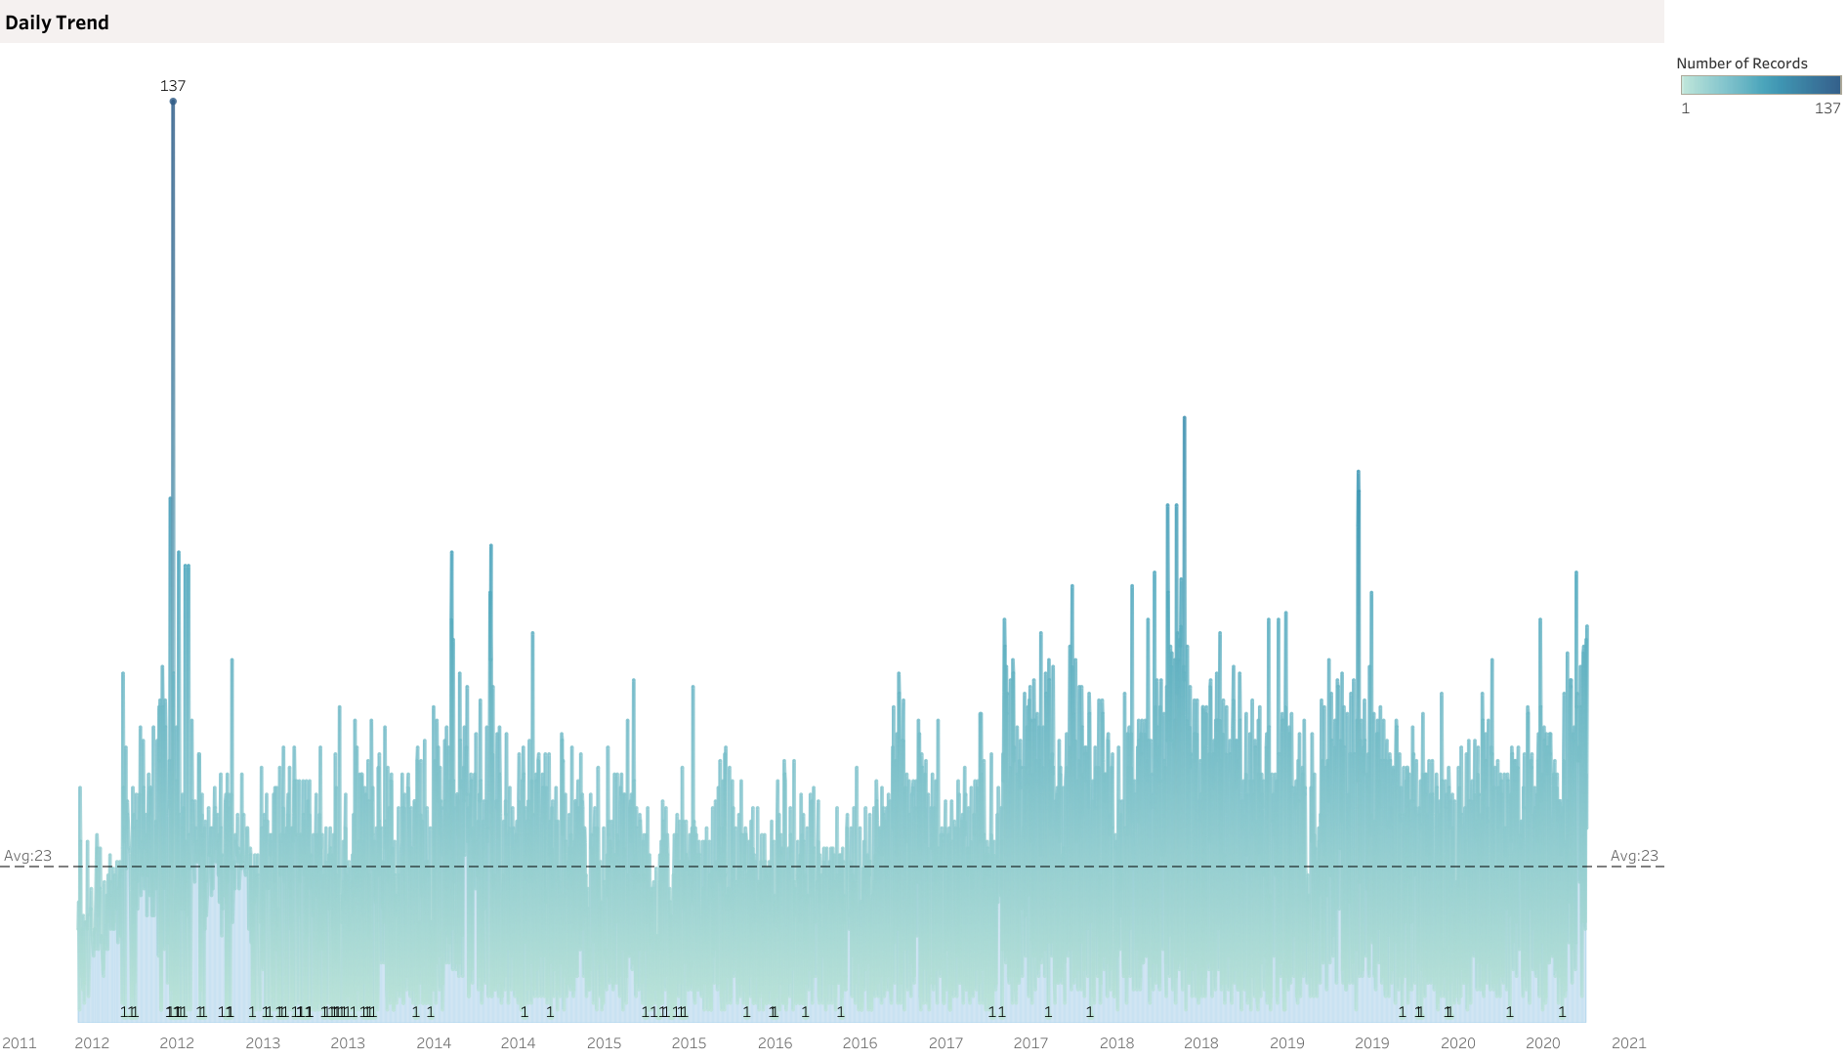
DAILY TREND

Slide 3
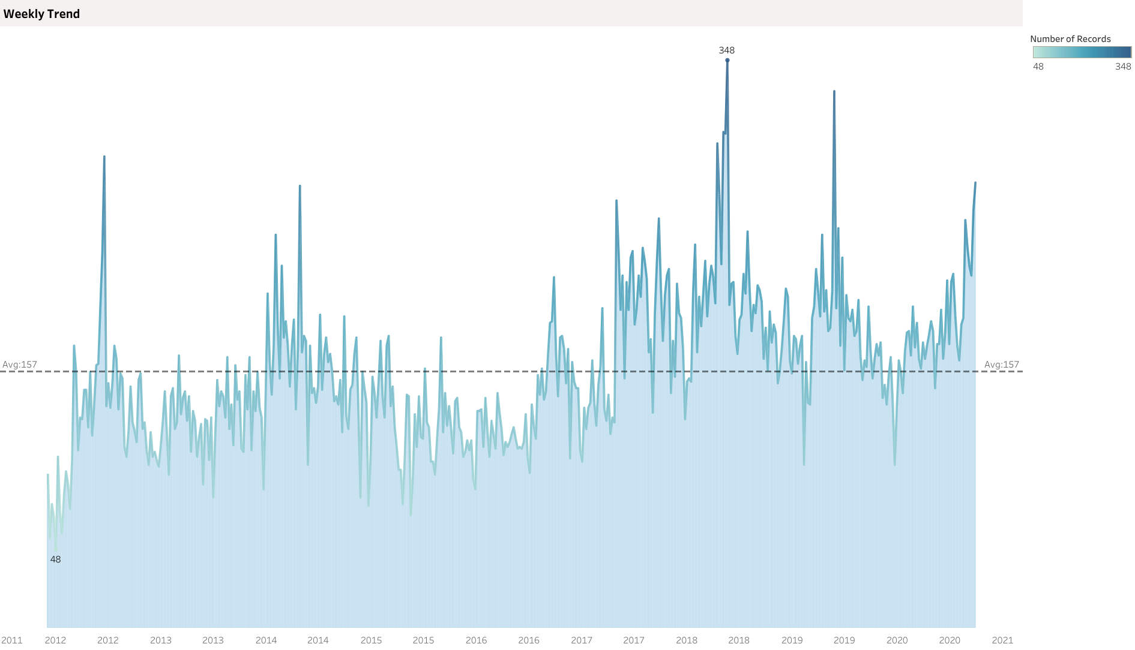
WEEKLY TREND

Slide 4
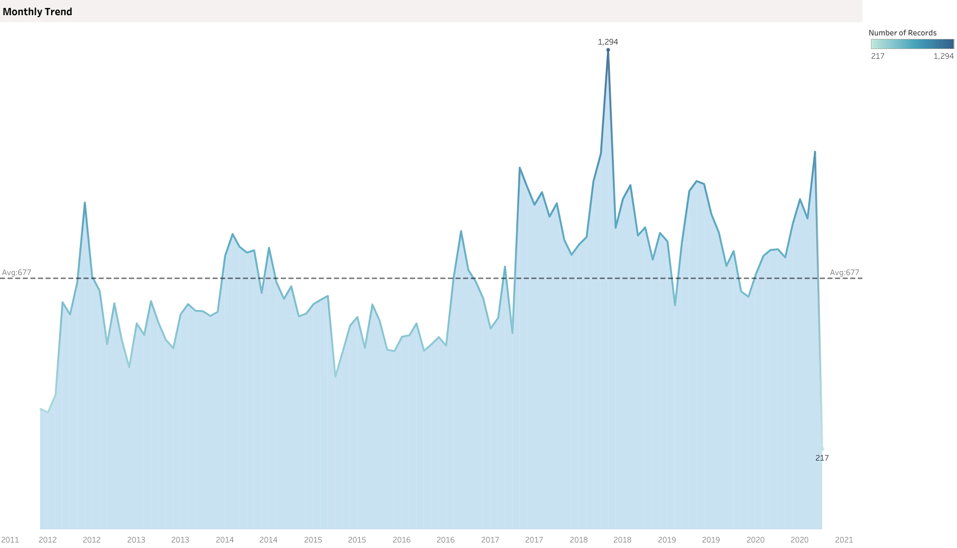
MONTHLY TREND

Slide 5
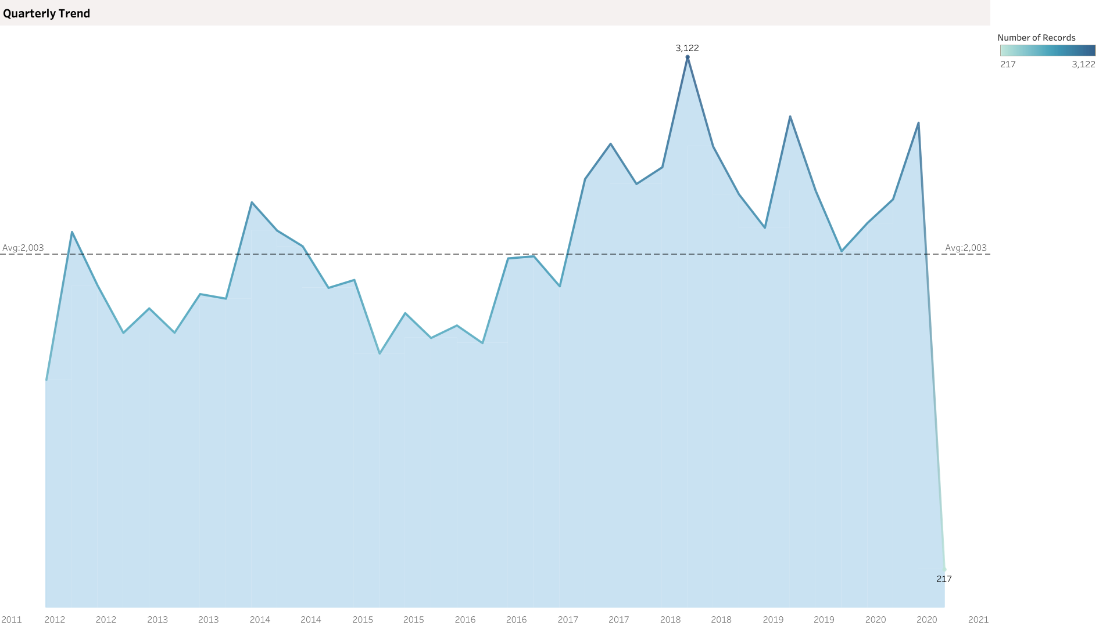
QUARTERLY TREND

Slide 6
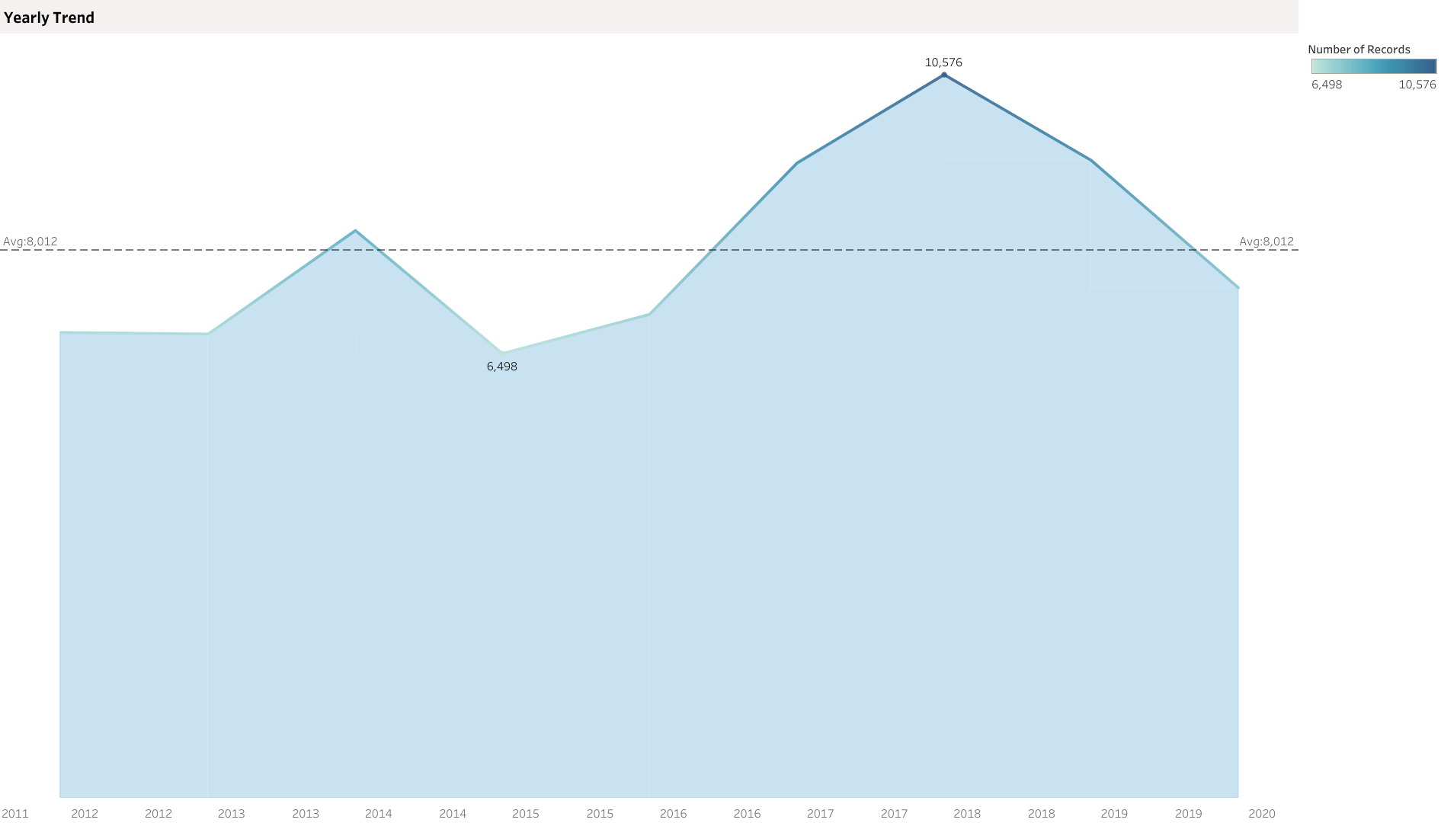
YEARLY TREND

Slide 7
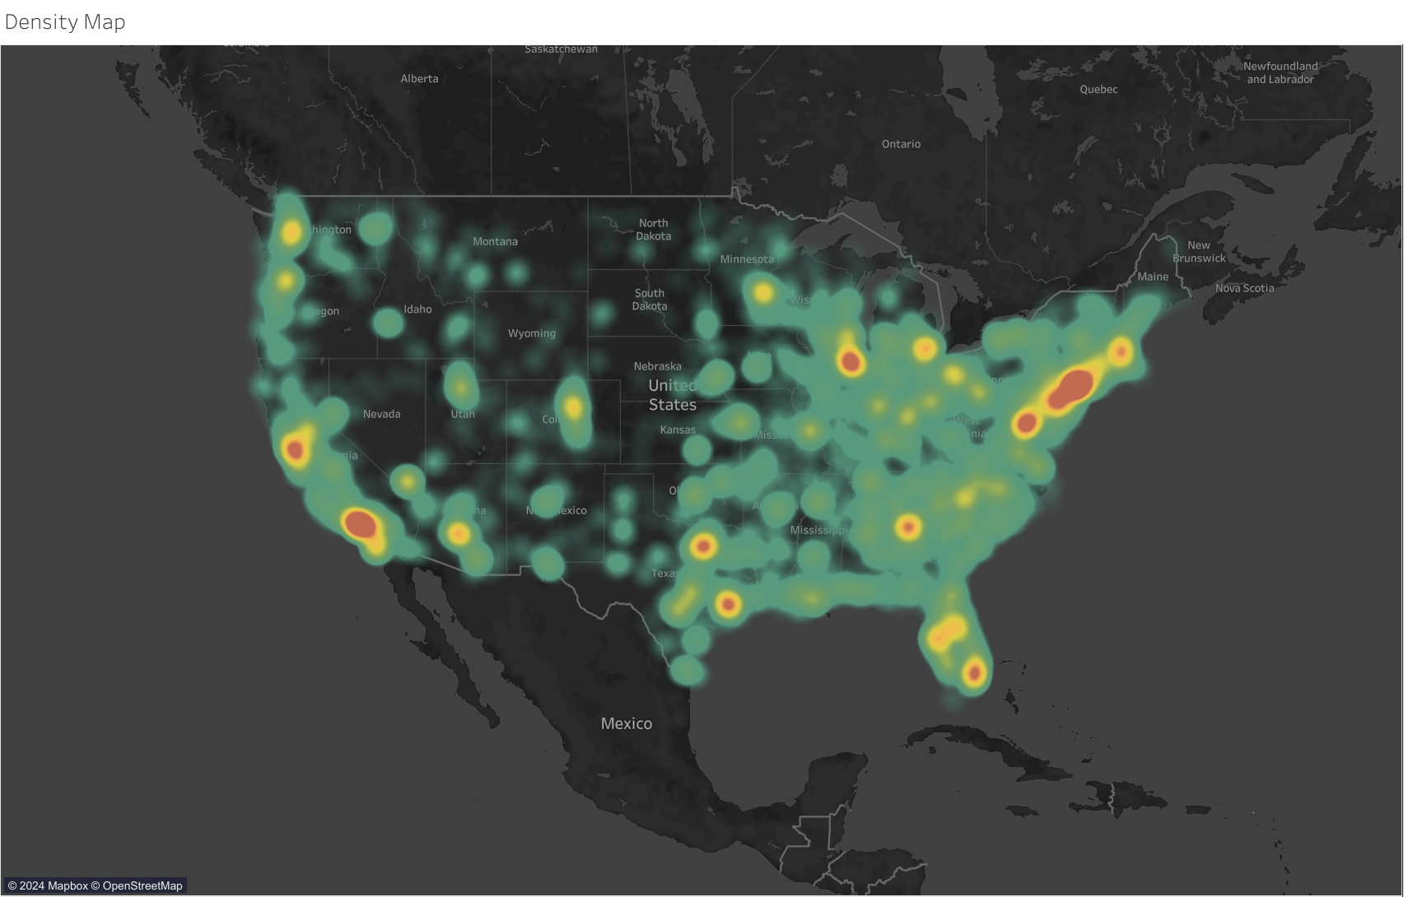
DENSITY MAP

Slide 8
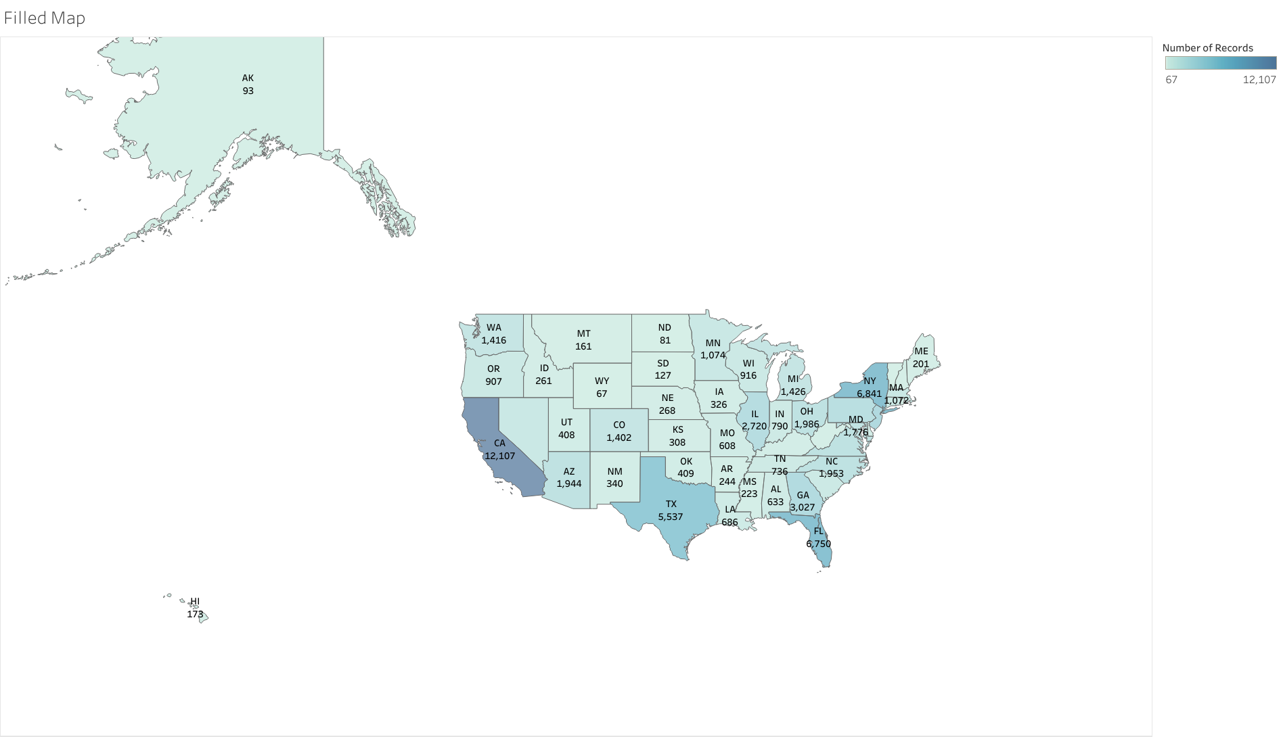
FILLED MAP

Slide 9
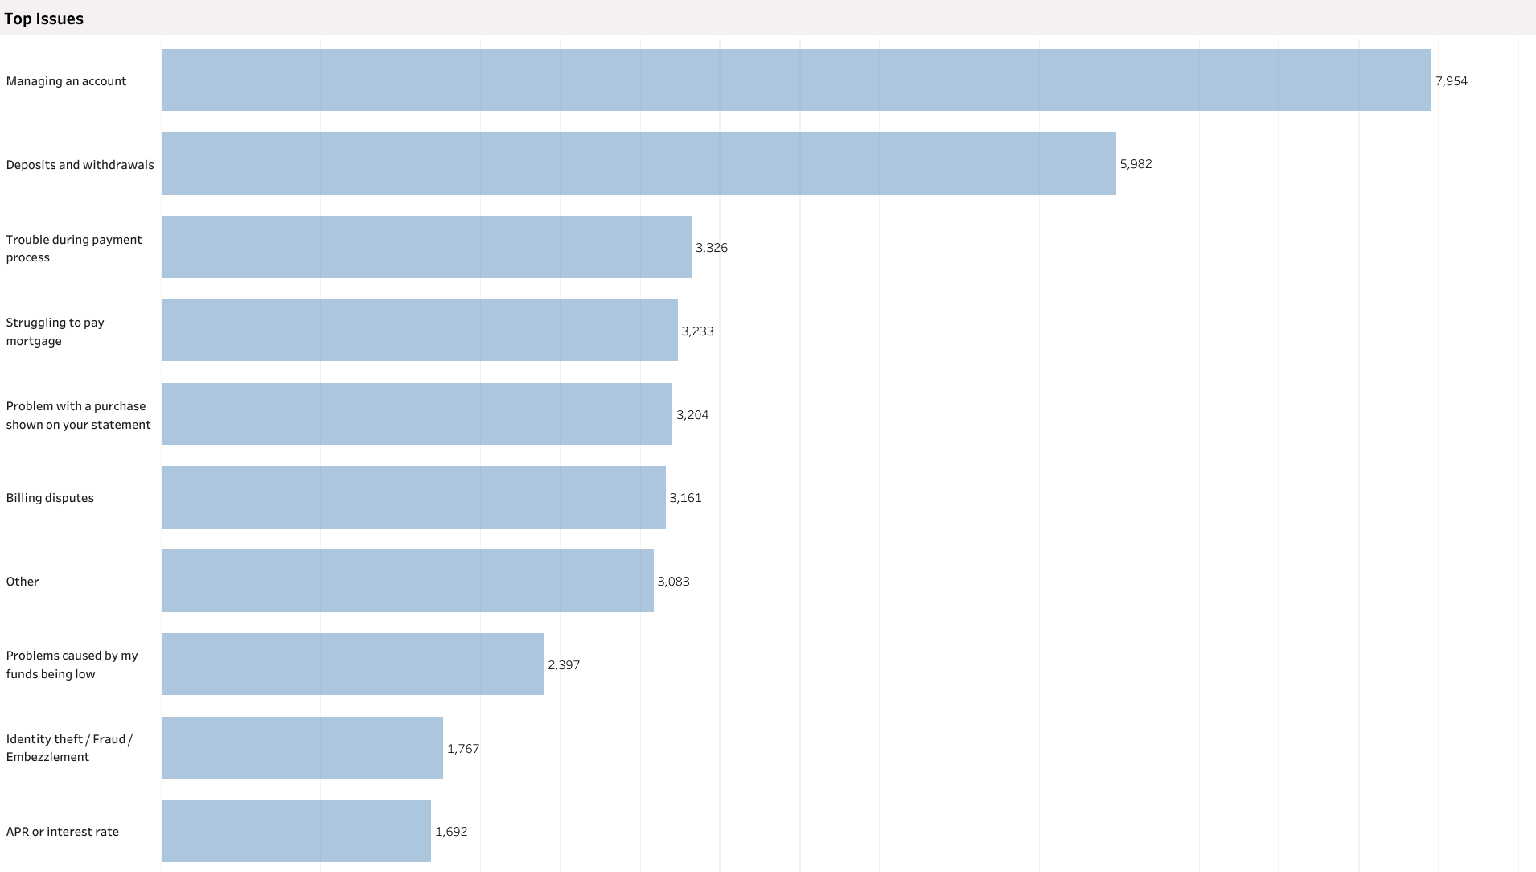
TOP ISSUES

Slide 10
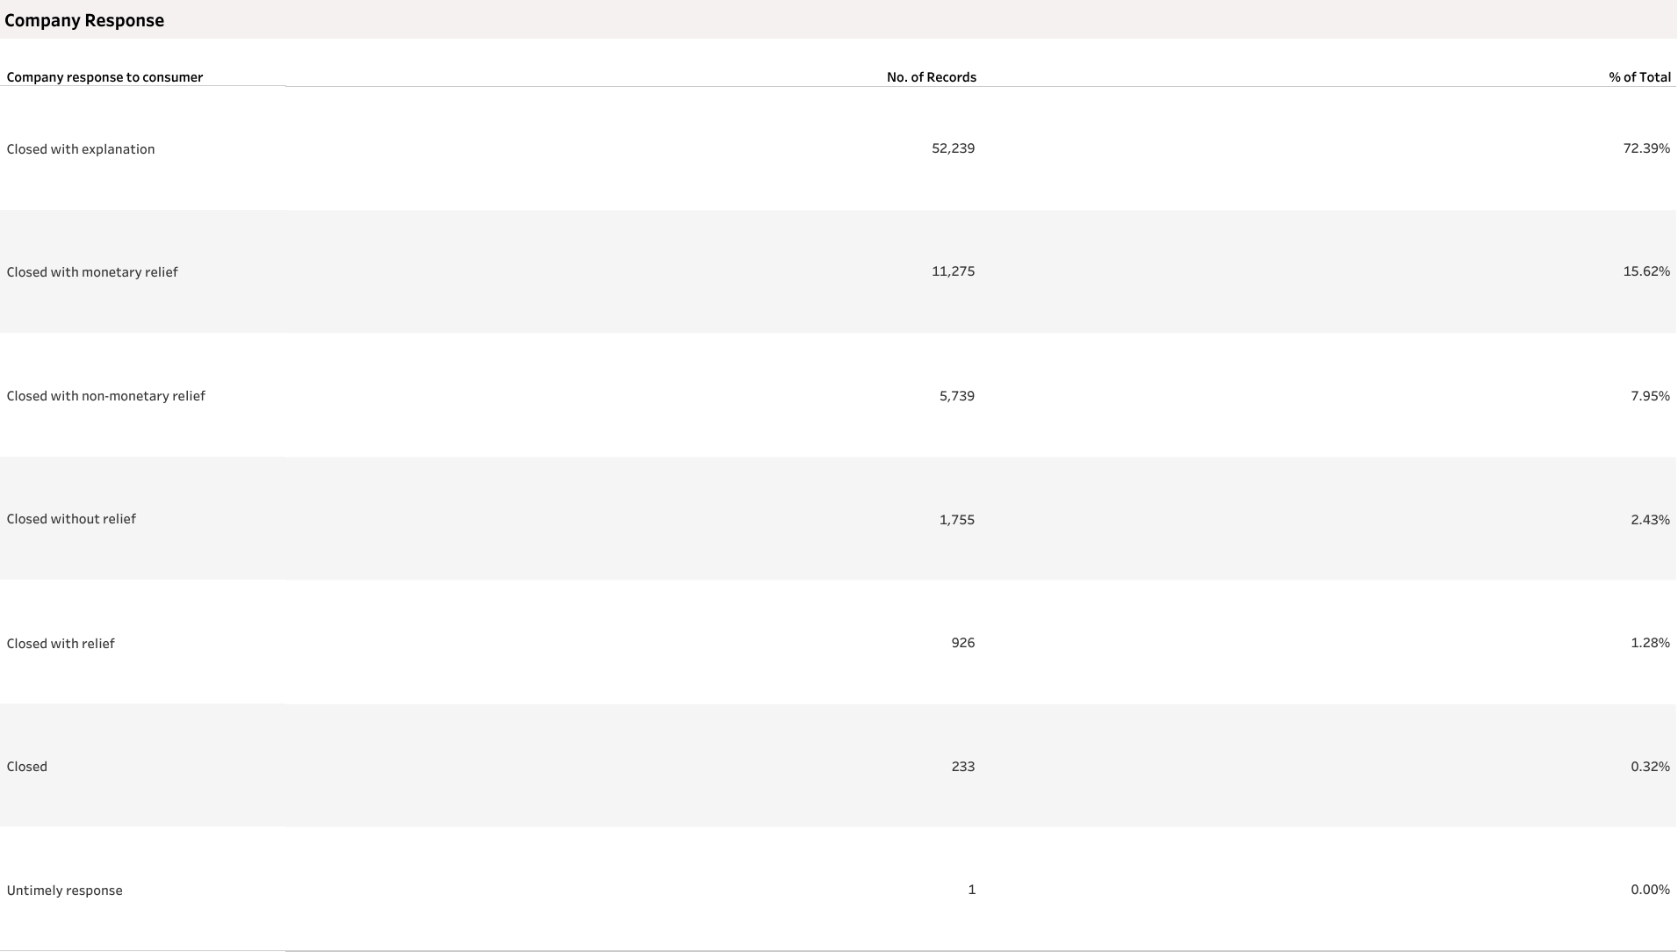
COMPANY RESPONSE

Slide 11
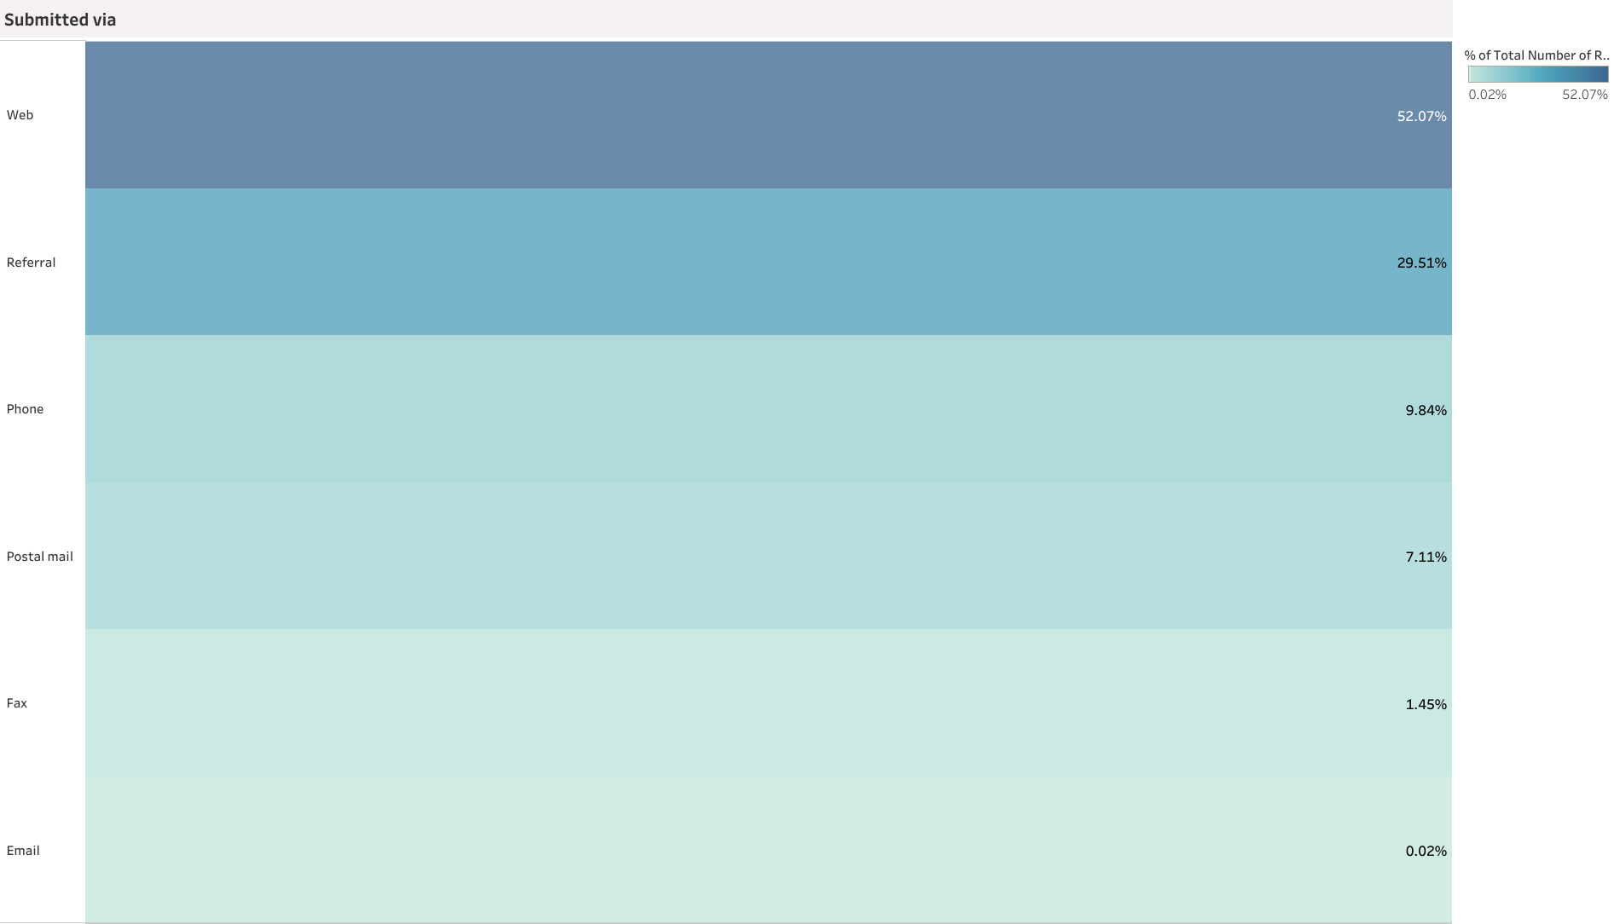
SUBMITTED VIA

Slide 12
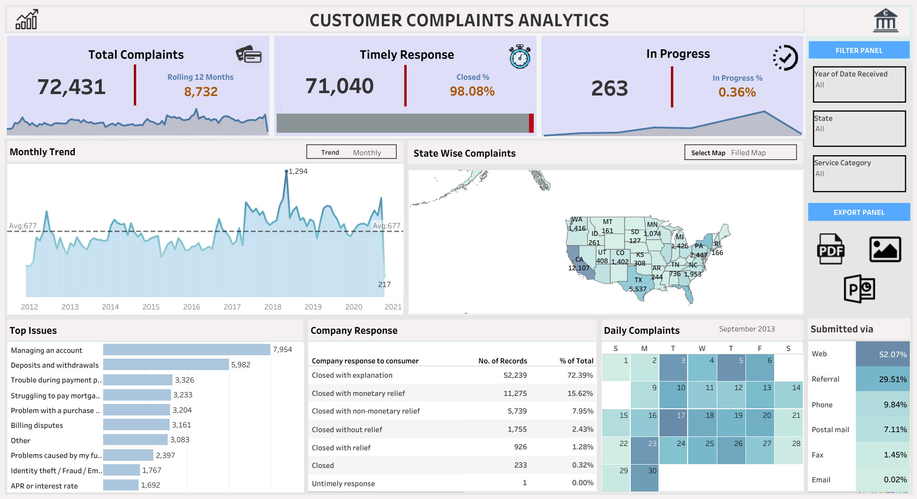

Slide 13
THANK YOU!

